Slide 1
Statewide Homeless Response System Redesign Hubs

Slide 2
Homeless Response System - 2020
Loose network of independently operated shelter providers – inconsistent collaboration between them
Service center municipalities – primarily Portland and Bangor – the default destinations for folks from areas with no/limited shelter services
Inconsistent collaboration between systems/providers in different areas around the state.
COVID hit – we knew we needed a regionalized system of coordination of services.
Statewide Homeless Council and MaineHousing partnered with consultants from CSH to redesign the homeless response system.

Slide 3
Key Take-Aways Informing Re-Design
Reliance on shelter as the initial front door
Most people enter from a setting where a short term intervention could prevent or end homelessness
Low number of long term stayers across the system
Over use of interventions with the poorest outcomes (e.g., ES)
There is a lack of permanent housing options on the back end … but once in housing, returns to homelessness are low - 7% within first six months
Notes:
Reliance on shelter as the initial front door
78% of people enter directly to shelter
Most people enter from a setting where a short term intervention could prevent or end homelessness
57% of people enter from a homeless situation (RHH)
32% enter from rental housing, home ownership, self paid hotel/motel or other situation (DIV)
Low number of long term stayers across the system
Over use of interventions with the poorest outcomes (ES and TH)
There is a lack of permanent housing options on the back end … but once in housing, returns to homelessness is low
7% within first 6 months

Slide 4
Key Components of the Redesign
Data Driven and Accountable
Person Centered Design
Grounded in Housing First
Balances statewide standards with a tailored, localized response
Addresses Race Equity

Slide 5
Three Levels of the System Design
Statewide Homeless Council and COC
Regional Homeless Councils
Program, advocacy and policy-level work
Local Service Hubs
Systems-level policy recommendations
Membership: Voting Members, EDs, State Agency Leadership, People With Lived Experience
Membership: Regional Reps and Senior/Executive Leadership, People With Lived Experience
Access, Assessment, Prioritization and Coordination for homeless response system; community level dashboards
Membership: Housing Navigators and Direct Service Staff

Slide 6
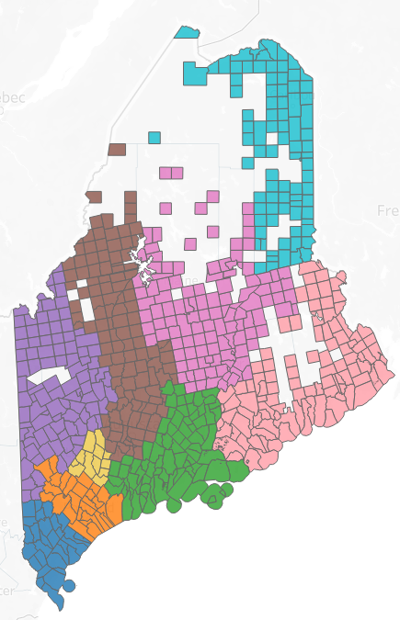
Service Hub Structure
Hub 1: York
Hub 2: Cumberland
Hub 3: Midcoast: Sagadahoc, Knox, Lincoln, Waldo and Towns of Brunswick and Harpswell
Hub 4: Androscoggin
Hub 5: Western: Oxford, Franklin and Towns of Livermore and Livermore Falls
Hub 6: Central: Somerset and Kennebec
Hub 7: Penquis: Penobscot and Piscataquis
Hub 8: Downeast: Washington and Hancock
Hub 9: Aroostook
Notes:
We has a special session to dive into the hub design
Creating a person centered design

Slide 7
Role of the Service Hubs
Provide the local foundation for the roll-out and operations of Coordinated Entry
Coordinated Entry Point of Access
Diversion, Triage and Assessment
Prioritization – maintain BNL
Referral - Housing matching and case conferencing
Support regional coordination and resource alignment
Community level dashboard to track data to improve performance

Slide 8
Service Hub Coordinators
Service HUB | HUB Coordinator
HUB 1 - York | TBD
HUB 2 - Cumberland | TBD
HUB 3 - Midcoast Maine | Amy Holland
Sagadahoc, Knox, Lincoln, Brunswick & Harpswell
HUB 4 - Androscoggin | Julia Kimball
HUB 5 - Western Maine | Emily Meade
Oxford, Franklin, Livermore and Livermore Falls
HUB 6 - Central Maine | Nicole Frydrych
Somerset and Kennebec
HUB 7 - Penquis | Jennifer Weatherbee
Penobscot and Piscatiquis
HUB 8 - Downeast Maine | Jace Farris
Washington and Hancock
HUB 9 - Aroostook | Shirley Caron
Notes:
Service HUB HUB Coordinator
HUB 1 – York Toby Simon
HUB 2 – Cumberland Matthew Jarrell
HUB 3 - Midcoast Maine Amy Holland
Sagadahoc, Knox, Lincoln, Brunswick & Harpswell
HUB 4 – Androscoggin TBD
HUB 5 - Western Maine Emily Meade
Oxford, Franklin, Livermore and Livermore Falls
HUB 6 - Central Maine Nicole Frydrych
Somerset and Kennebec
HUB 7 – Penquis Jennifer Weatherbee
Penobscot and Piscatiquis
HUB 8 - Downeast Maine Jace Farris
Washington and Hancock
HUB 9 – Aroostook Shirley Caron

Slide 9
Who should be at the table in each HUB?
Shelters
Outreach/PATH
Supportive Housing Providers
CAP Agencies
General Assistance
Child and Family Services
Public Housing Authorities
Hospital/Healthcare Community Care Teams
County Jail and Prison Discharge Planners
Mental Health Service Providers
Cultural Broker Organizations

Slide 10
IMPLEMENTATION PLAN
Contracted with Community Solutions
Built for Zero Initiative
Built for Zero is a rigorous national change effort designed to help a core group of committed US communities end chronic and veteran homelessness.

Slide 11
Implementing a Functional HUB and CES System.
Phase 3: BfZ HUB Teams – Begin working to achieve Quality Data
April 2022 ->
Phase 2
Hire Hub Coordinators
HUB CES Implementation
March 2022 - ongoing
Phase 1
Establish Service HUB Teams
Nov - Dec 2021
February 2022: Launch BfZ Maine State Team - Clearing the Path for Local Teams

Slide 12
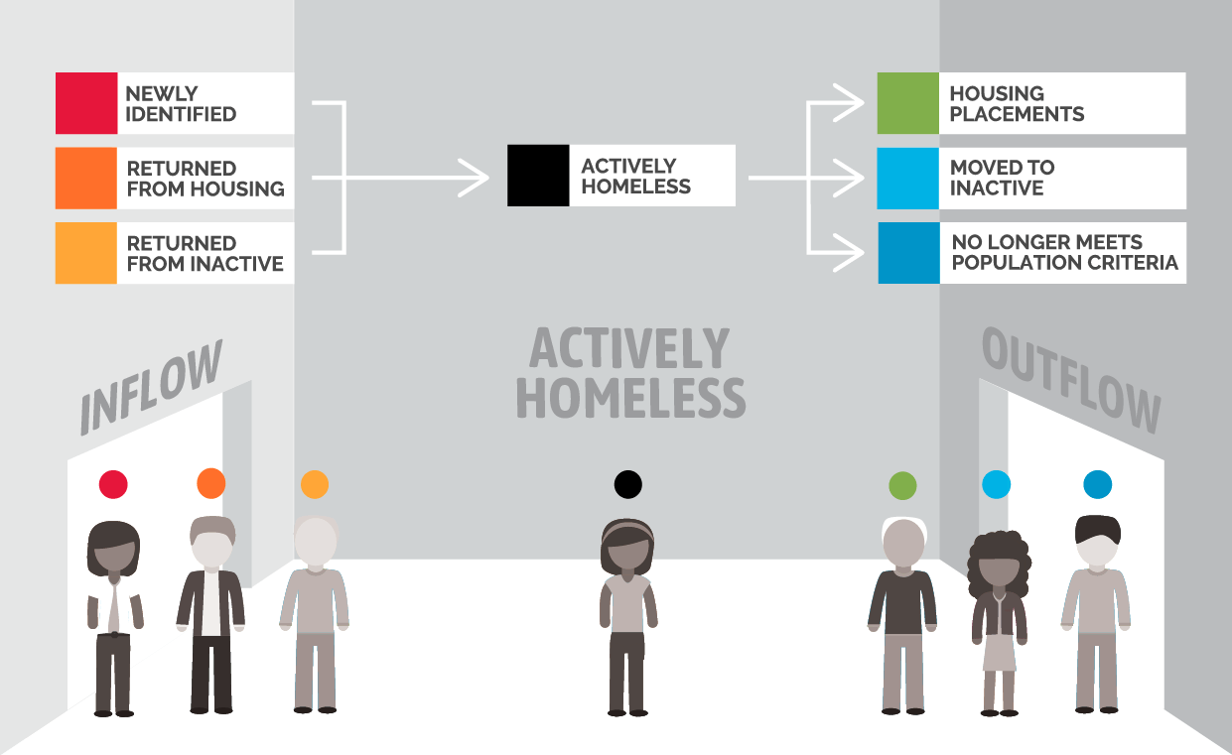
Reaching Quality Data

Slide 13
